Slide 1
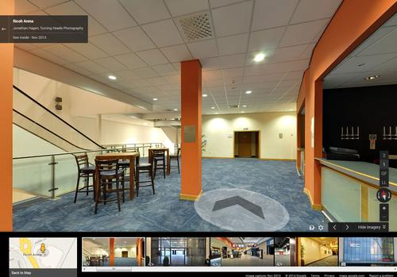
Augmented reality indoor navigation app
Team blueprints
Justus Karenzi
Sudi Nsengiyumva
Jeremy Fischer
Jordan Ziegler
Dylan Shanahan

Slide 2
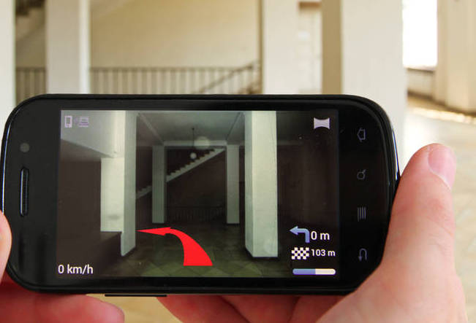
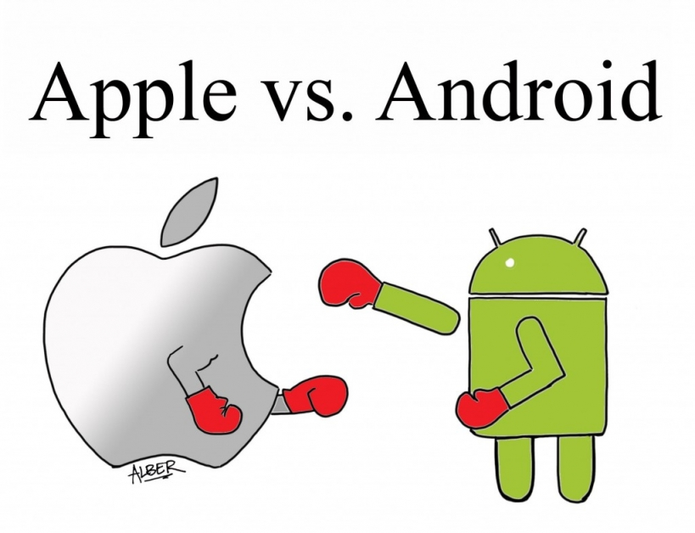

Initial Problem Statement

Slide 3

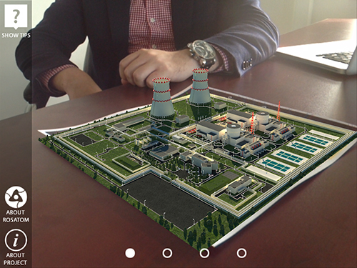

Background Research and Relevant Technology

Slide 4
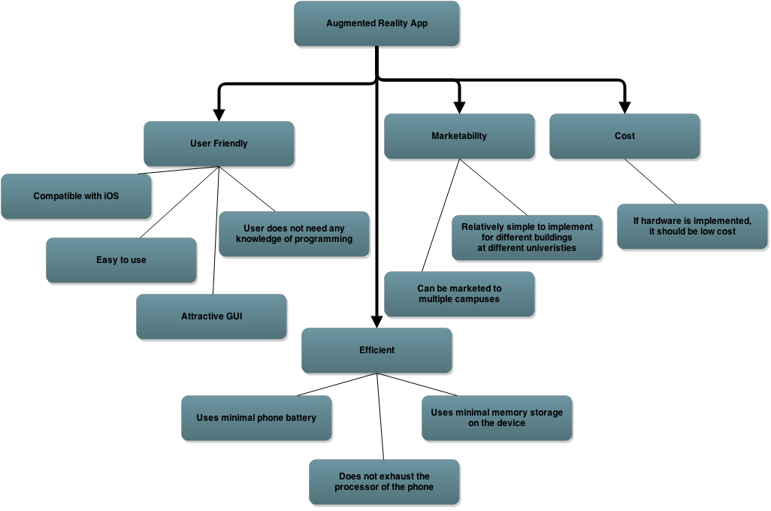
Objectives Tree

Slide 5
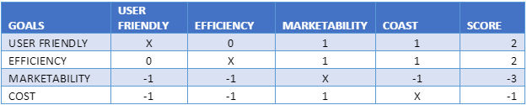
Comparison Chart
-1: The goal in the row is less important than the goal in the column.
0: The goal in the row is equally important to the goal in the column.
1: The goal in the row is more important than the goal in the column.
x: Cannot compare goal relative to itself

Slide 6


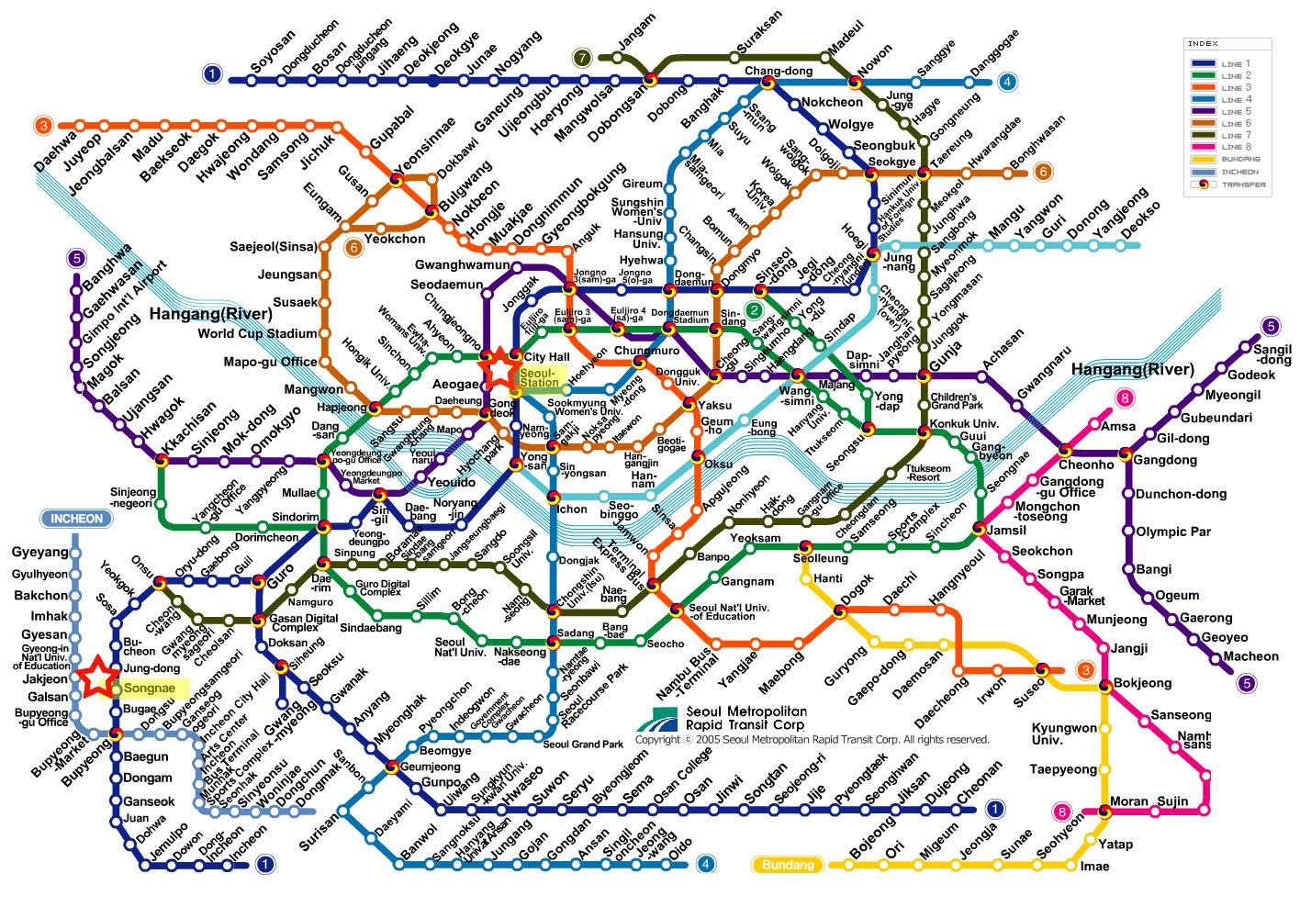
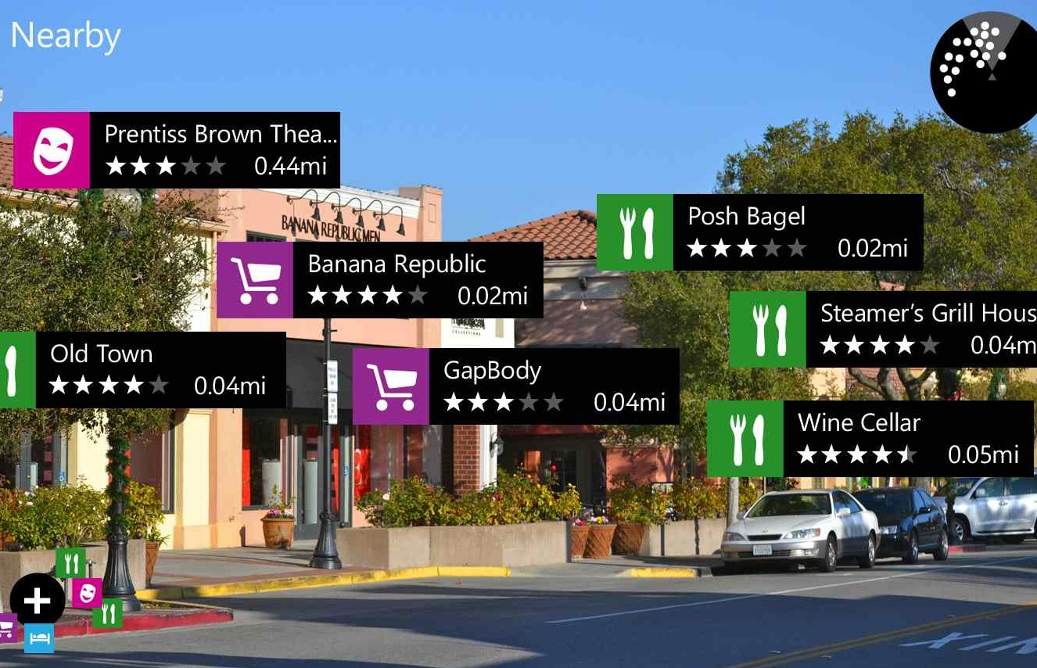
Problem Definition

